Slide 1

High Speed Face Recognition System
March 2018

Slide 2
High Speed Face Recognition System
Why do we need it?
Problem statement:
The prevailing system to identify a person involves lot of manual work. There is no such automated tool that can identify a person using real time camera feed.
Eg: ID card checks at airport, ID & Prescription verification at Pharmacies.
Our answer to it:
In order to automate the current tedious process, we have built a tool using Deep learning on Tensorflow that allows identification of a person just by face.
This POC can be deployed in multiple industries/ fields.
eg: Retail stores, Hospitals, Airports etc.

Slide 3
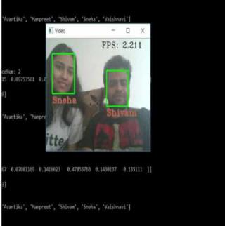
What does it look like?
Real Time Face Recognition

Slide 4
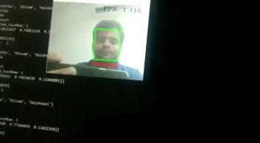
Working Prototype
Play Video

Slide 5
Business Cases and Scopes
Employee welfare Tracking
Healthcare
Face Payments
Smart Advertising
Office Access
Criminal identification
Home Security
Road Security
Attendance Systems
Pharmacy
Login Systems
Human Tracking

Slide 6
User Experience
Smooth Transition
No Human Intervention
No need to carry ID cards around Any More
Ease of Implementation
New faces are added and trained in less than 30 seconds
The model is able to detect face in less than 1 sec on our current laptops which do not contain GPUs

Slide 7
Benefits of Data Science Approach to Tracking System Few Generic Applications
High Speed Face Recognition System
Automate Medicines at Pharmacies
Next time you visit the hospital pharmacy just show your face and the medicines could be waiting for you at the counter.
Tighter Security
All corporation’s premises would be protected since you’ll be able to track both the employees and any visitors that come into the area. Anyone who doesn’t have access or permission to be there will be captured by the recognition system that alerts you instantly about the trespassing.
Many Industries
One Tool
Forget Time Fraud
High Success Rate
One of the big benefits that facial recognition technology companies offer is the time attendance tracking that allows excluding the time fraud among the workers. No more buddy favors from securities for staff members, since everyone now has to pass a face scanning devices to check-in for work
Facial biometrics technology today has a high success rate, especially with the emergence of 3d face recognition technologies. It is extremely difficult to fool the system, so you can feel secure knowing that your biometrics computer security system will be successful at tracking time and attendance while providing better security.

Slide 8
Thank you

